Slide 1
Canteen Management System
Shahbaz Khan (388)

Slide 2
01
02
03
04
Introduction
Functionalities
Future Work
Approach & Schema

Slide 3
Introduction
Real-time application for canteen , from where user can see menu of the University canteen and place their orders as well.
User can track their orders.
Every user have specific profile.
Canteen owner can manage Categories , food items , and orders.

Slide 4
Functionalities
Verification & Validation.
Categories.
Food list.
Food details.
Cart.
Order Details.
Order Status.

Slide 5

Approach
Approach
In this project we’ve two modules (Admin and Client) . So , we need to synchronize both apps in real-time. To achieve this we use below mentioned flow.
Admin Side
Client Side

Slide 6
Client Side
Sign up / Sign in
Home Page
Menu
Orders
Cart
Sign out
Food list
Update / Delete
Update / Delete
Food Detail
Add to Cart

Slide 7
Admin Side
Sign in
Home Page
Food list
Menu
Orders
Sign out
CRUD operations on Category
Reject / Update order Status.

Slide 8
Stack
Android Studio
JAVA
Firebase Realtime Database
SQLite3

Slide 9
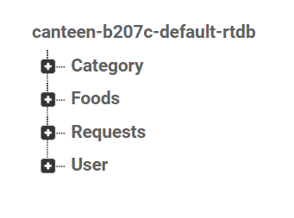
Database Schema

Slide 10
Future Work.
Work on UI.
Online payments.

Slide 11
Thanks!
Code is available at github.
https://github.com/canteen-management-system

